Slide 1
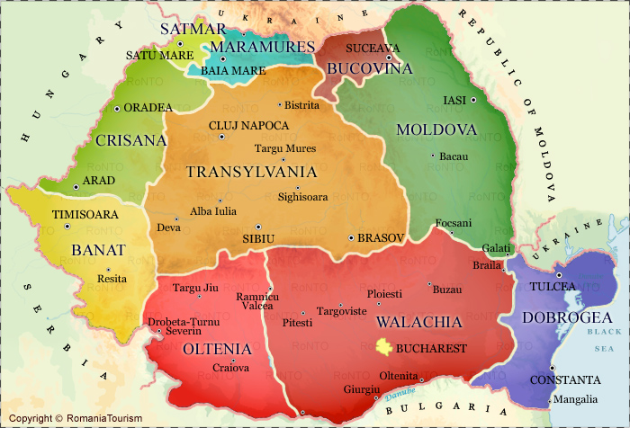
Skype Meeting
Nelas (Portugal) – Stei (Romania)
Wednesday 16th
10.30 – 12.30
Fátima Cunha – Cornelia Frai

