Slide 1
The Innovation Project
Week 3

Slide 2
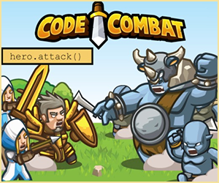
Using Code to Teach in an Entertaining/Kinesthetic Way
The CodeCombat game is a browser-based role-playing game that teaches the programming languages JavaScript and Python, as well as the fundamentals of computer science.
How to play:
In order to advance through the game's levels, players must prove their knowledge by writing code. It includes both single-player and multi-player components, and is targeted at a secondary school audience.

Slide 3
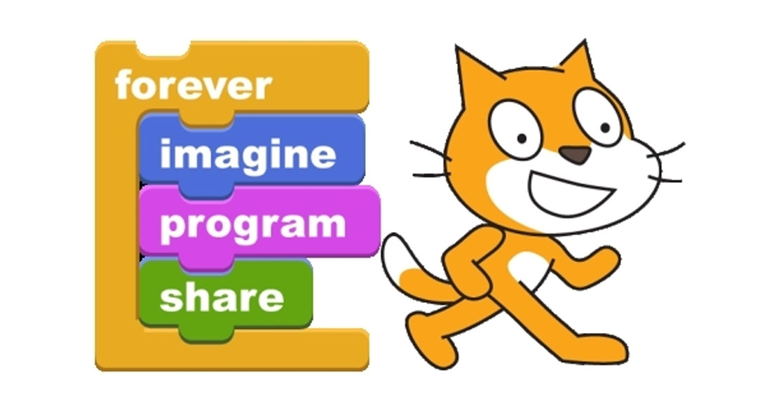
The Power of a Cat: -Simple Code that makes a HUGE Difference
Scratch is a visual programming language and online community targeted primarily at children. Using Scratch, users create their own interactive stories, games and animations, then share and discuss their creations with one another.

Slide 4
…THE FIRST STEPS TO TECHNOLOGICAL DEVELOPMENT…

Slide 5
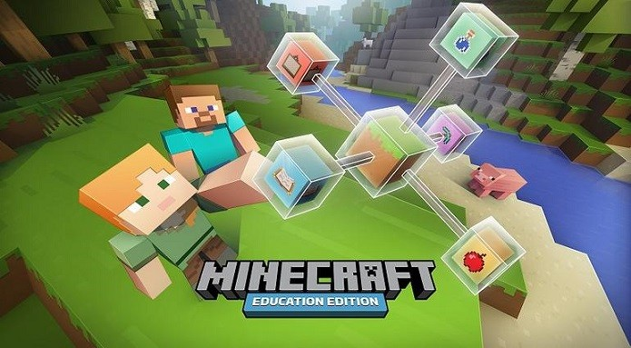
MINECRAFT: Education Edition

Slide 6
STEM: (Science, Technology, Engineering, Math)

