Slide 1
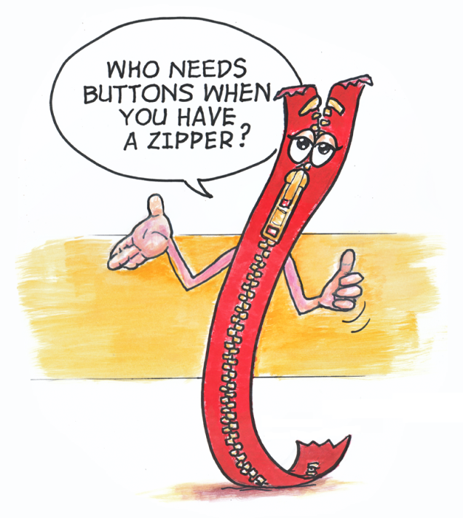
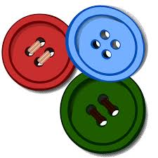
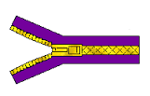
SOFT EDUCATION: Closures of clothing products
Profesor: BOLOHAN ROMEO
Şcoala: LICEUL TEHNOLOGIC MIHAI EMINESCU DUMBRAVENI, SUCEAVA, ROMANIA

Slide 2
PROCESSING OF REAGENTS OF TEXTILE PRODUCTS
Class: Traineeships
Branch: Technological
Basic training: TEXTILE INDUSTRY AND SKIING
Field of general training: TEXTILE AND LEATHER INDUSTRY
Qualification: Textile Manufacturer

Slide 3
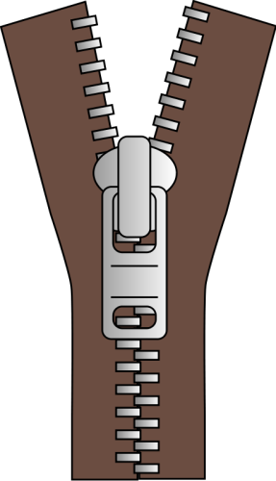
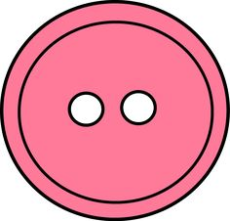
Closing items for clothing products
The initial role of the closures was functional, to ensure that the products were put on / undressed and / or the movements moved lightly. Subsequently, closures have also been used for aesthetic diversification, many times, specific closure solutions being used to decorate other product elements.

Slide 4
Classification of closures
Closures of clothing products can be constructively and technologically differentiated according to:
position of the edges: superimposed, joined;
placement mode: over the entire length of the product, on limited areas;
accessories used: buttons, zippers, buttons, staples, stitches, buckles, string, bows, brandburgs, ribbons etc .;
the role of closure: functional, aesthetic or combined.

Slide 5
Diversificarea estetică a închiderilor
When solving the closures, special aesthetic effects can be obtained by:
Edge processing;
positioning of product closure;
accessories used;
grouping buttons and buttonholes;
solving drums, etc.

Slide 6
Închiderile cu fermoar
Zip fastenings have a wider use, the functional-aesthetic performance of the zip fasteners as well as the recent hidden application technologies, giving rise to undeniable advantages over other predominantly functional closures.
Zip fasteners can be placed over the entire length of the product or on limited areas, on the front or back of the product, on the side, at the end of the sleeves or on the pants, etc., on a wide range of products.

Slide 7
Zip fasteners
Zip fasteners may play a predominantly functional role, in which zipper teeth are simply or double-coated, or predominantly aesthetic, when the teeth are visible and the slider can be of special shape.
The zippers can have metal or plastic teeth, can be detachable or fixed to one or both ends, etc.
Lately, decorative zippers have been made, which give a note of novelty to the products they use.
For applying zips, a modified foot is required. Applying with two-needle machines and devices is only possible when the zippers are continuously fed from the tape to which the cursor is attached later.

Slide 8
Zip closure with a functional function

Slide 9
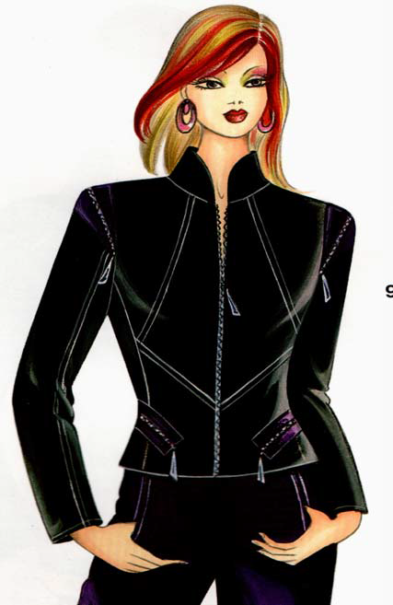
Zip fasteners with a decorative role

Slide 10
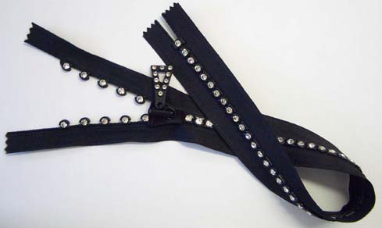
Decorative zips

Slide 11
Zip fasteners with aesthetic role
Zip fasteners with an aesthetic role can be placed on a wide range of items and sub-assemblies of the product: blouse, jacket, dress, skirt, long sleeve ends or trousers, side skirts, jackets, pants, but the zipper as such can also be used outside the closures.

Slide 12
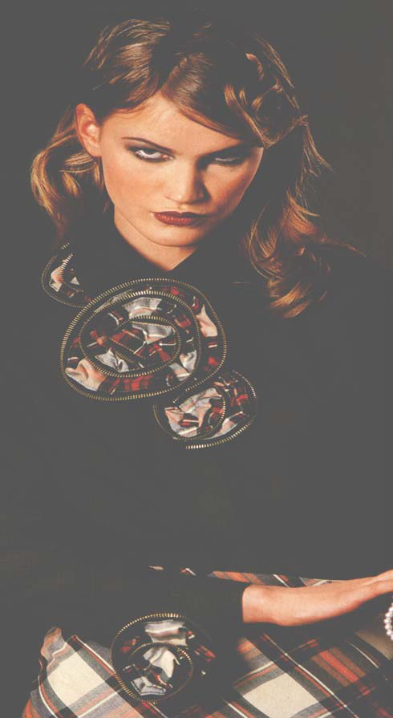
Using zips for decoration and stiffening

Slide 13
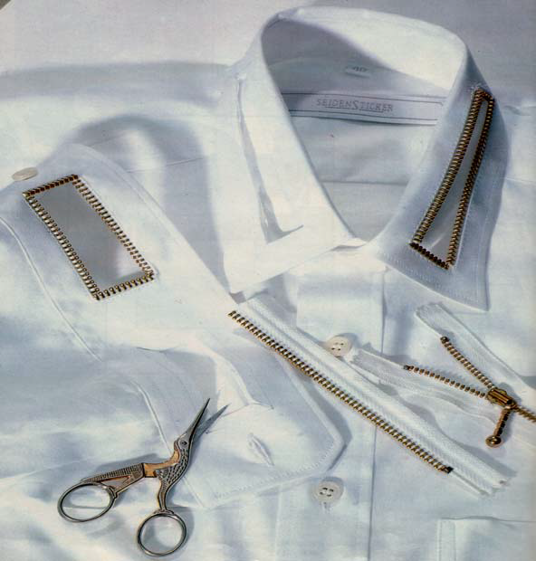
Using the metal zip for finishing edges of cutouts

Slide 14
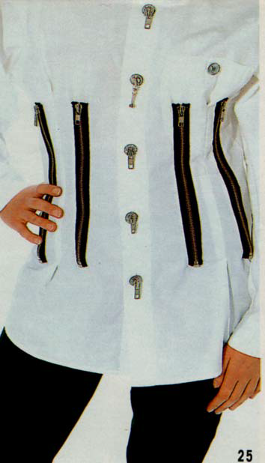
Placing the zipper on bumps

Slide 15
Bibliography & Webography
Papaghiuc, Viorica, Variante tehnologice de confecţionare a produselor de îmbrăcăminte, Editura Performantica, Iaşi, 2008
Papaghiuc, Viorica; Creţu, Mioara, Modalităţi de diversificare a produselor de îmbrăcăminte prin prelucrări tehnologice, Editura Performantica, Iaşi, 2006
www.textile-technique.com

