Slide 1
What innovations made the world better?
By innovation we understand new, and usually by new we also understand good, so, as most creations are made to help the world become something a little bit better in an aspect, let’s see what innovations are probably most beneficial to the world.

Slide 2
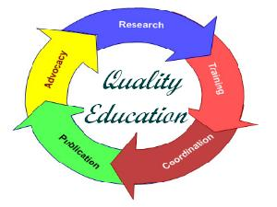
Quality Education
“Ensure inclusive and equitable quality education and promote lifelong learning opportunities for all”
As we see, the definition doesn’t only speak of education, but also of lifelong learning opportunities. Not just that we will, no matter what, keep learning all out lives, but with this we can make is easier. This program ensures that all children have access to early childhood development and can complete free, equitable and quality primary and secondary education leading to effective learning outcomes.

Slide 3
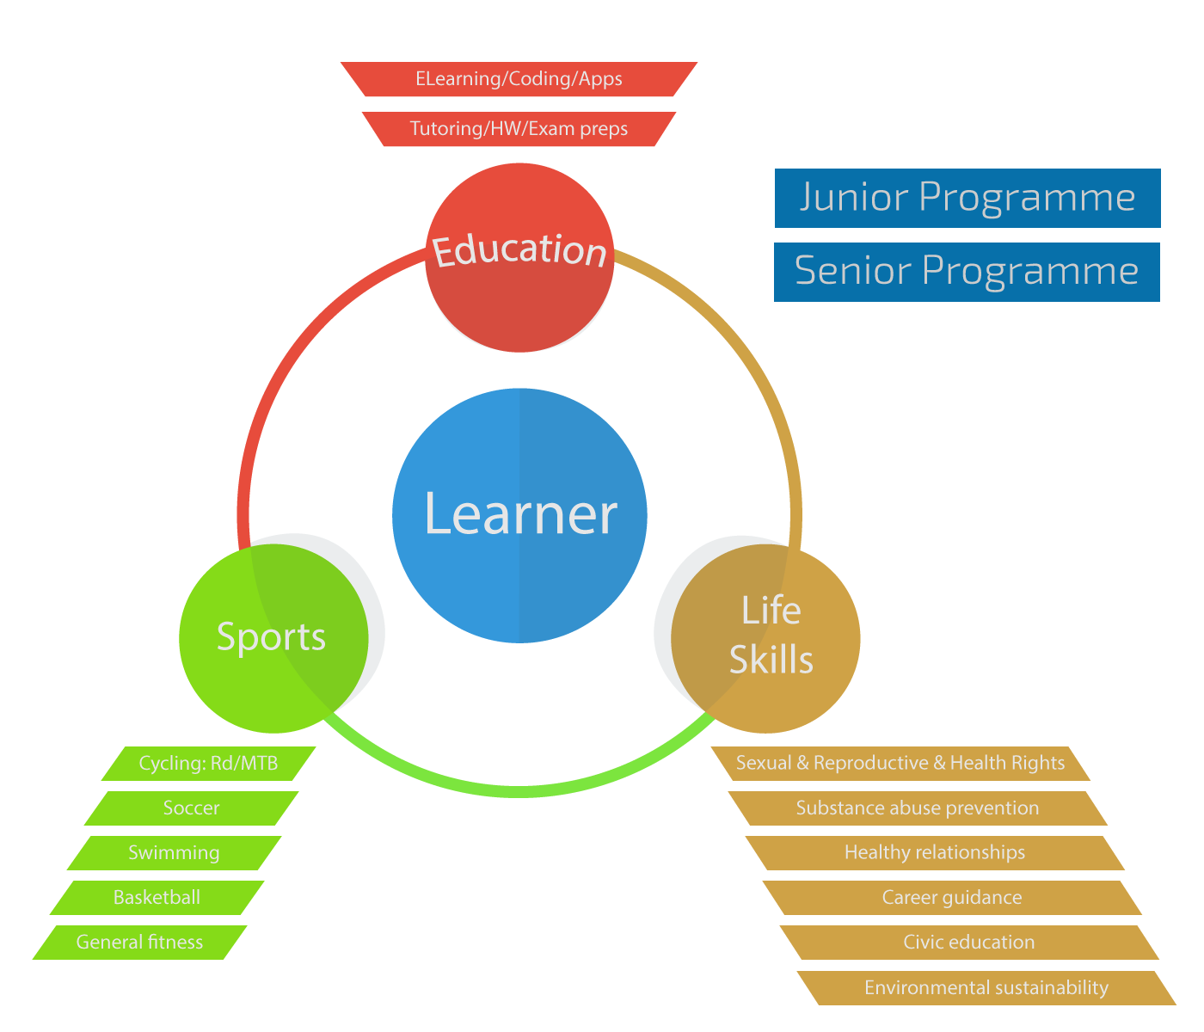
PAY(Physically Active Youth is a program in which the work with the youth is learner-centred. “The learner brings to us a wealth of knowledge and social experience gained from the family, the community and interaction with the environment.”
These are the 3 pillars that sustain the holistic youth development. It provides safe and nurturing learning environment for Namibian children and youth coming from disadvantaged communities in Katutura.

Slide 4
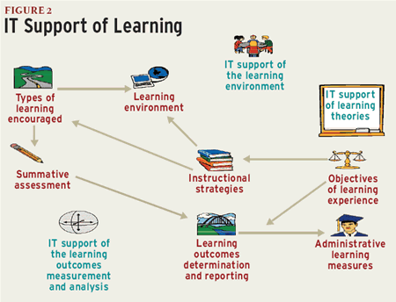
What are the most important innovations for quality education?
Certainly the work many people put in to make learning for poor children possible is extremely useful and shows just how much power of will we have. Also elevating the quality students work nowadays allows them to discover a better path in becoming what they have in mind.
As for the poorer ones, it opens a new way and helps them evolve, so they could start an advanced job or even a more comfortable life.

Slide 5
We understand that quality education is an important aspect we must achieve, so for accomplishing it and many other goals what we need are resources. This implies a responsible consumption and production.
“Sustainable consumption and production is about promoting resource and energy efficiency, sustainable infrastructure, and providing access to basic services, green and decent jobs and a better quality of life for all.”
The need for resources is continuous and the danger of running out of them is constant, as we acknowledge the wastes we make. The only hope in saving the planet’s environment is by redistributing the “wastes” to poorer countries where they could provide useful supplies.

Slide 6
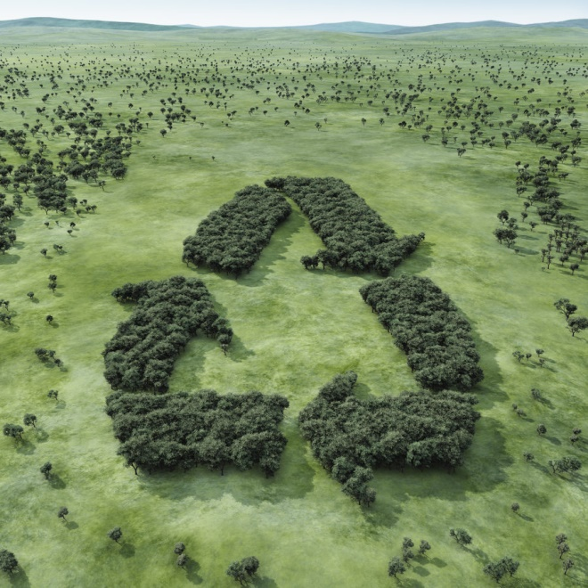
Resources and uses
We permanently encounter problems with supplies and resources, mostly in industry where they are needed the most. For not this reason only we shall start improvising ways to make better uses out of supplies and recycle what is considered eventually “unusable”.
Recycling might be the only way out of this that will bring us to the surface. Because resources are limited we have to first use them as much as we possibly can, then, when we will run out, find a new inhabitable system that sustains life and presents a high variety of supplies usable by mankind.

Slide 7
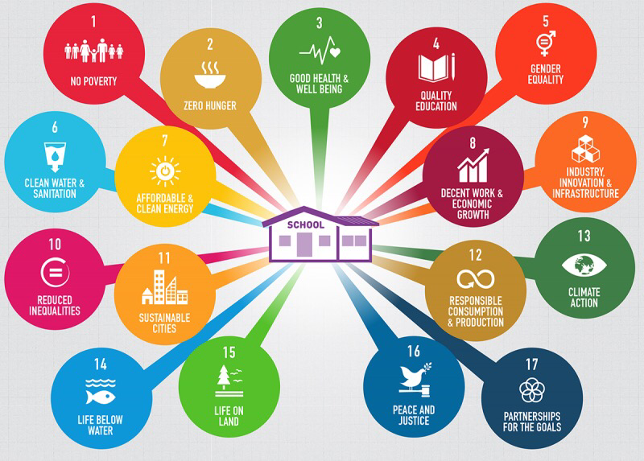
As far as we can see, the world is changing and we have to change with it. Yet not everything allows us, so we need to improvise; this is called innovation.
Written by: Alex Constantinescu, Iosif Teodor, Licarete Tudor, Petrovici Liviu

