Slide 1
Innovation of SDGS
Technological education at Technological High school “Mihai Eminescu” Dumbraveni, Suceava County, Romania

Slide 2
On April 27th, 2018, April in the second week activities, 7th and 8th grade students from Dumbraveni, Romania debated the issue of sustainable development and sustainability through brainstorming and collage. Within these activities, the following several themes were debated.

Slide 3
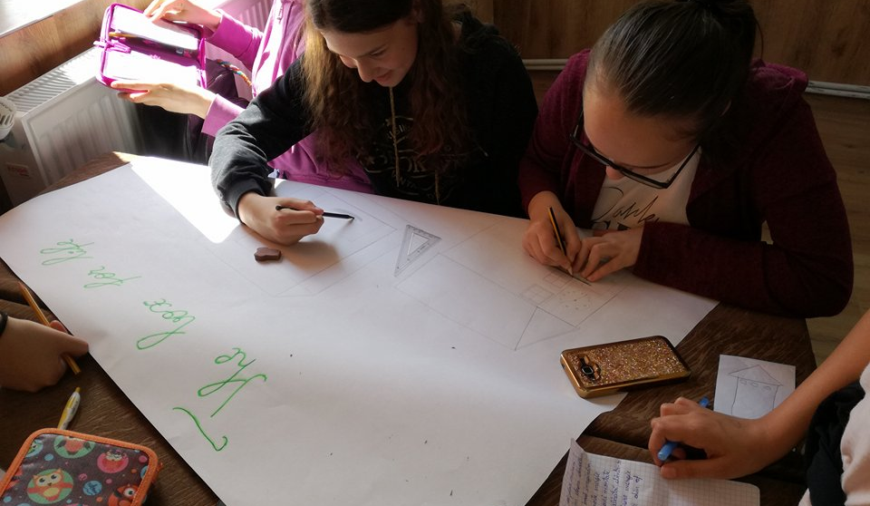
A box can do wanders? Even if we talk about sustainable development.So,we imagine a box that transports energy by means of panels mounted on the sides of a box made of a glass and supplying electricity to schools in Africa.

Slide 4
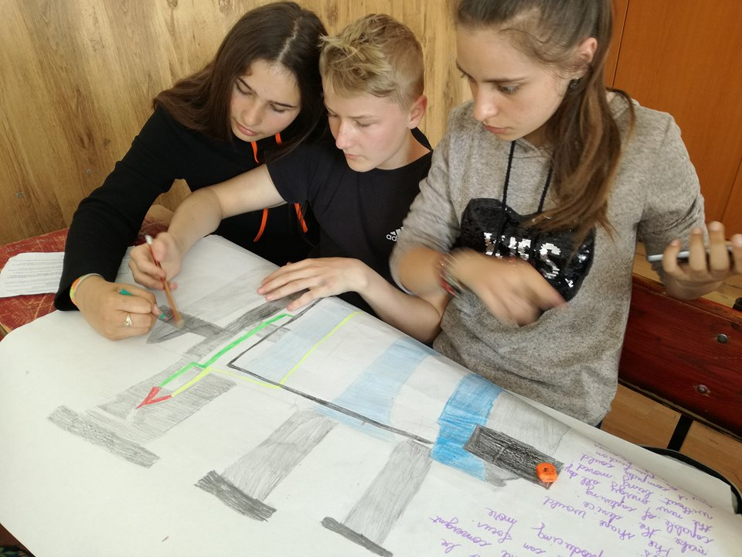
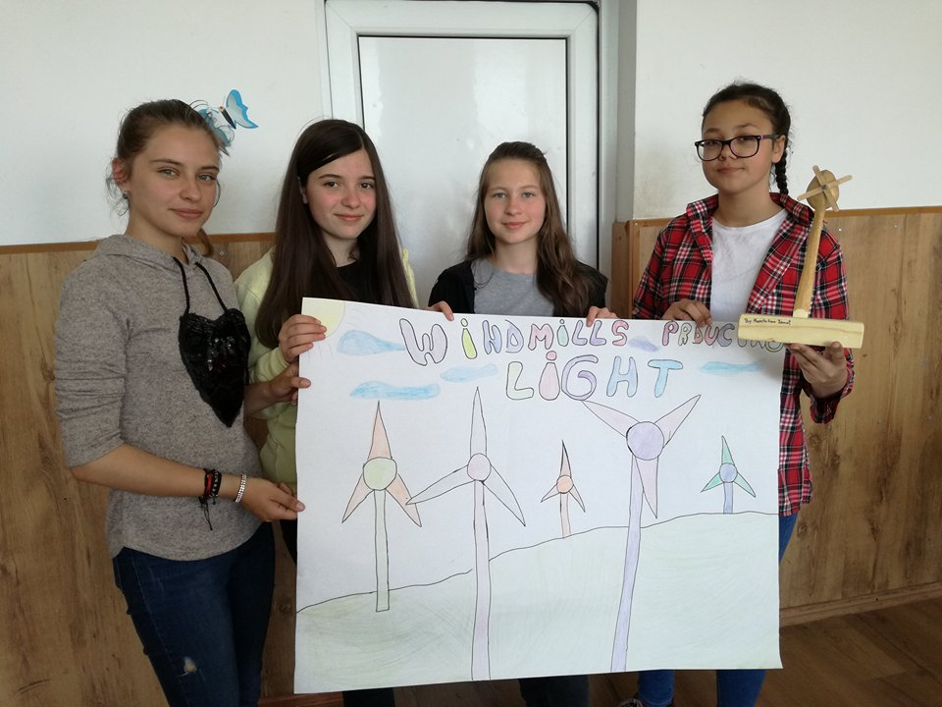

Slide 5
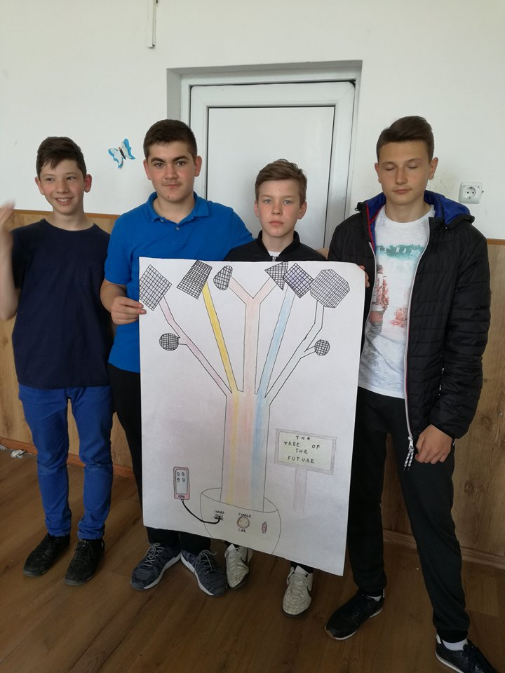
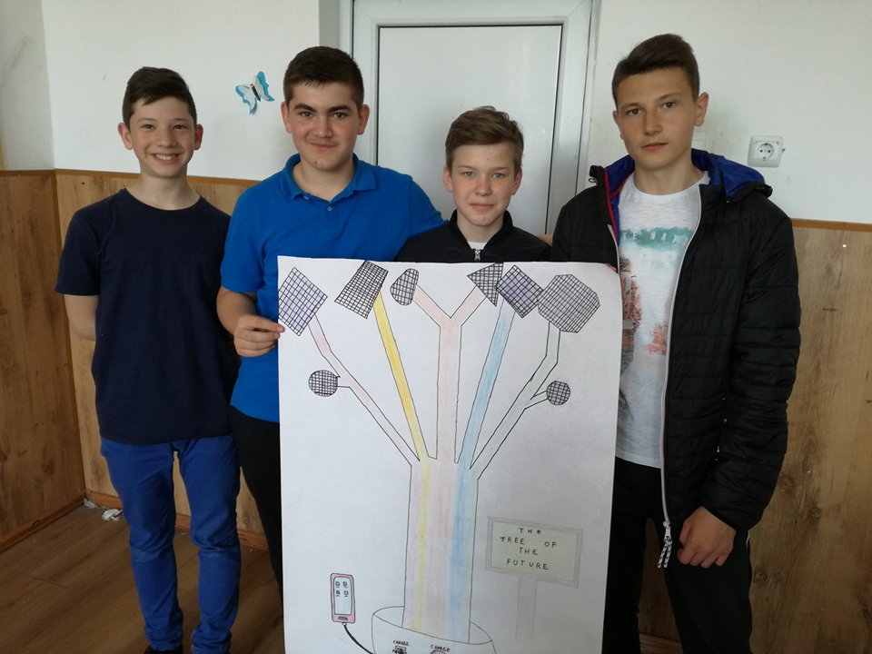
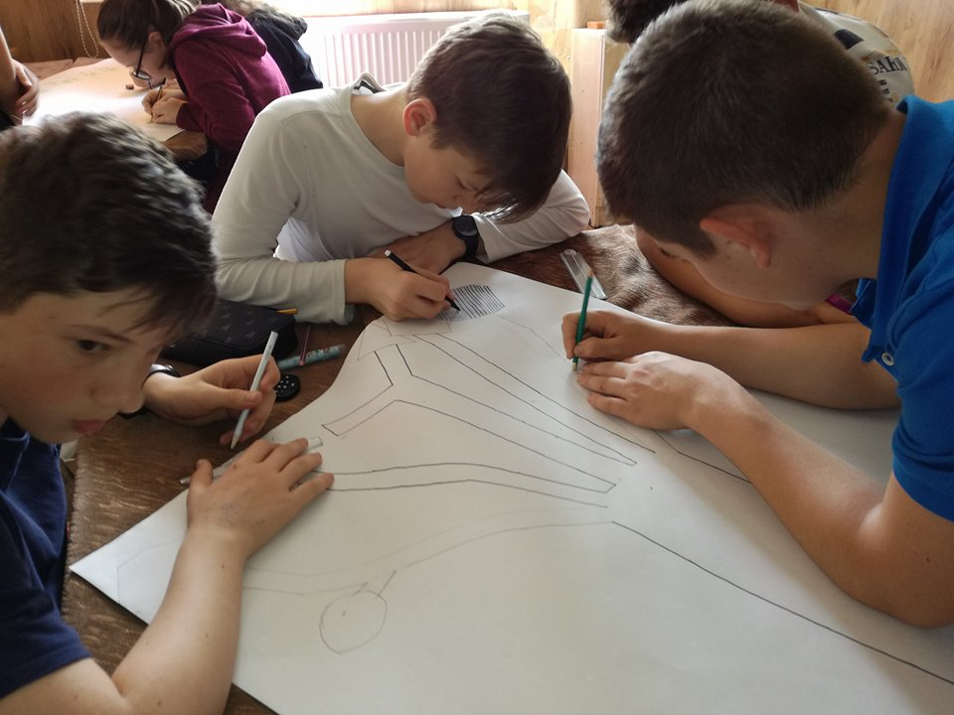

Slide 6
