Slide 1
Life below water
By Neacsu Razvan Marian and Pircalabescu Andrei

Slide 2
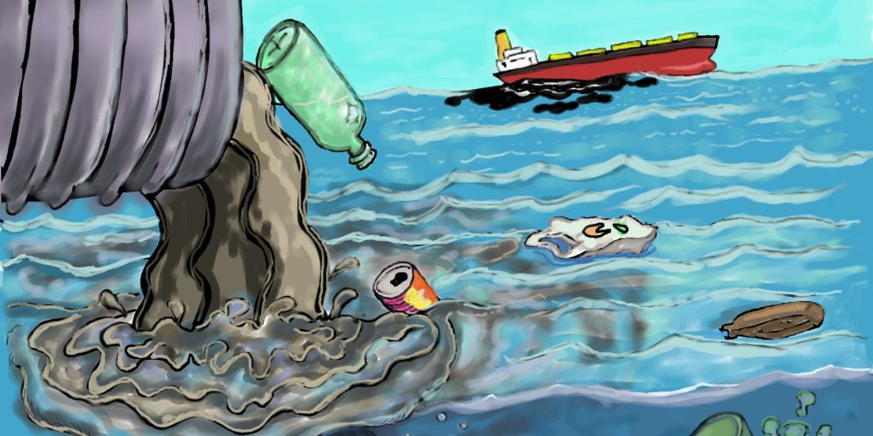
Introduction
The life of our fish friends is not as protected as we would love to believe. Several key factors are intrinsically destroying their habitat, such as climate change and overfishing. Therefore, it is our duty to help them. Thankfully, there are several innovations out there designed for that.

Slide 3
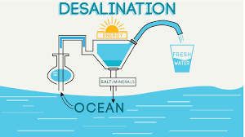
Innovations
You are probably curious about what innovations are making the world better for our water friends. Among them, we can name a process, developed by New Jersey Institute of Technology chemical engineering professor Kamalesh Sirkar which is designed for removing the salt from the ocean waters so we can tap the vast ocean waters for or how sand and gravel have been used to purify water for thousands of years.

Slide 4
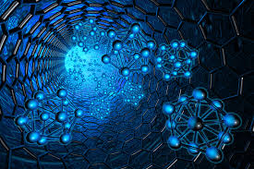
Our top 5 innovations
We are quite fond of innovations such as:
1 -desalination;
2- the creation of special places for fishing;
3 -salt for purification as used in several African countries;
4- nanotechnology; 5-the MadiDrop, which utilizes silver or copper nanoparticles to kill bacteria.

Slide 5
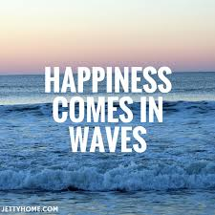
Quotes about water
“Water is life, and clean water means health” - Audrey Hepburn “We don’t know who discovered water, but we’re certain it was not a fish” -John Culkin

Slide 6
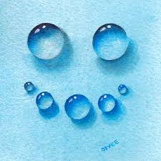
Our opinion
We are looking forward to help the water life in the best way possible. We believe we as humans who enjoy drinking water and swimming are responsible morally to not let this habitat to decay day after day.

Slide 7
THANK YOU FOR YOUR ATTENTION!

