Slide 1
Innovation project
Bharat ram global school
Greater Noida

Slide 2
What is an innovation ?
This Photo by Unknown Author is licensed under CC BY-SA

Slide 3
What is innovation
Innovation can be defined simply as a "new idea, device or method". However, innovation is often also viewed as the application of better solutions that meet new requirements, unarticulated needs, or existing market needs.

Slide 4
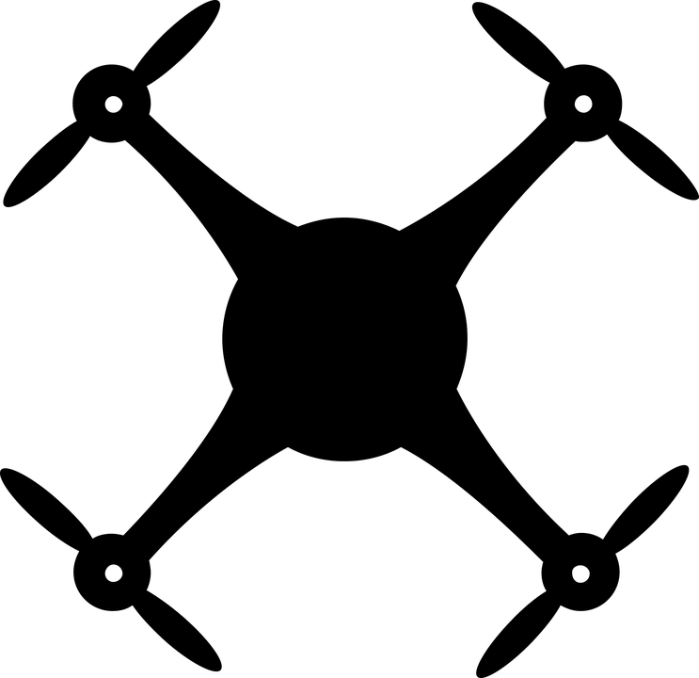
Examples of some innovation around the world
AGRICULTURAL DRONES
Farmers have begun to use agricultural drones adorned with cameras to improve the treatment of their crops. The drones allow farmers a unique perspective that previously-used satellite imagery could not provide. They help to expose issues with irrigation treatment, soil variation, and distressed plants at a much lower cost than methods like crop imaging with a manned aircraft.

Slide 5
ULTRAPRIVATE SMARTPHONES
As concerns over personal privacy grow, particularly in terms of new technology, a Maryland-based company seeks to provide an alternative. Silent Circle, encrypts clients’ voice calls, text messages, and file attachments. Encryption prevents potential eavesdroppers from listening in on phone calls and protects metadata. Silent Circle has big plans for the future including a secure smartphone called Blackphone. Blackphone will utilize encryption tools currently used by Silent Circle, as well as other software that will help secure data.

Slide 6
MICROSCALE 3-D PRINTING
The potential of 3-D printing technology has many people excited about new applications. But current printers have important limitations. Up until recently, most 3-D printers can only use plastic. A group of researchers at Harvard University, led by Jennifer Lewis, have started to develop new 3-D printer inks. Her team prints intricate objects using materials that are chosen based on their mechanical properties, electrical conductivity, or optical traits. Eventually new inks will enable a wider variety of functions, including artificial organ creation.
This Photo by Unknown Author is licensed under CC BY-SA

Slide 7
Innovations may come with benefits and drawbacks
This Photo by Unknown Author is licensed under CC BY-SA

Slide 8
Some examples of such innovation are:-
Cars- they help us to travel long distances but they also pollute the
environment
Mobile phones- they useful are useful to us as we the whole world in palms
but they can also harm our eyes.

Slide 9
How will you imagine a day in 2030
Imagine you are waking up in a spring of 2030, your personal robotic assistant he wakes you up and summarises today’s plan. And your automatic solar powered windows open and the cold morning breeze come in. Your shower uses very little water or soap. It recycles your grey water and puts the excess heat back into your home’s integrated operating system. While you dress, your artificial intelligence (AI) assistant plays your favourite tunes. When it’s time to leave, an on-demand transport system has three cars waiting for you, your spouse and your kids. On the road, driverless cars and trucks move with mathematical precision, without traffic jams, routine maintenance or road rage. Accident rates are near zero.

Slide 10
Which innovations are making roads sustainable ?

Slide 11
Noise-reducing asphalt: “There have been a few cost-benefit analyses done that show that using asphalt to reduce noise levels makes more sense than constructing sound wall barriers,” says Jim Bird, director of performance for the Western Canada Asphalt, Paving & Construction product line at Lafarge. Durawhisper is a Lafarge product designed to reduce traffic noise while meeting all the normal specifications for hot-mix asphalt. It’s ideal for use in residential areas.
This Photo by Unknown Author is licensed under CC BY

Slide 12
Full-depth reclamation: Repairing roads has traditionally involved removing the old asphalt pavement and hauling it off-site for disposal. Full-depth reclamation is a repairing technique in which the old asphalt is mixed with the underlying gravel and the resulting asphalt/gravel combination is used to form a new road base.
Mixing the asphalt into the gravel has been proven to produce a better-quality base material, saves the cost and environmental implications of removing the old asphalt from the site and reduces the amount of new aggregate used.

Slide 14
Plastics Recycling Process
Sort and clean different plastic groups
Melt plastic into bales
Break bales up and grind into small flakes
Wash, rinse and dry flakes in hot air
Color maybe added or maybe run through a pelletizer
Note - Impossible to recycle at 100% .

Slide 15
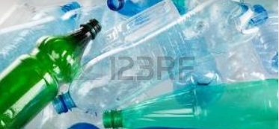
Reused Plastic Bottle
After used plastic drink bottle, don’t just throw it away, use it to make something awesome. Check out these below low cost, creative and functional craft projects that will transform the humble plastic bottle into everything from useful storage to great home decor.
The slides shows next will give you a glance of how plastic bottle can be reused.

Slide 16
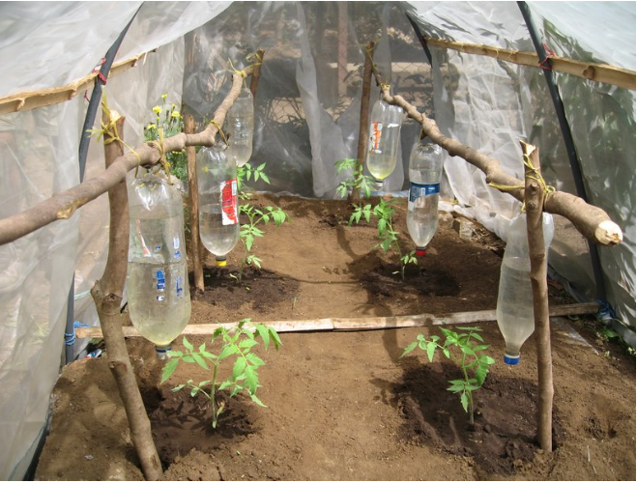
1. Drip Irrigator
Drip irrigation delivers moisture directly to plant roots without oversaturating the soil, which helps the plants root deeper and grow healthier since they don’t experience moisture stress. Grab some 2 liter plastic bottles, punch two holes into the caps, and hang or plant the bottles next to the plants. Fill them with water and let the plants get the slow watering they prefer.

Slide 17
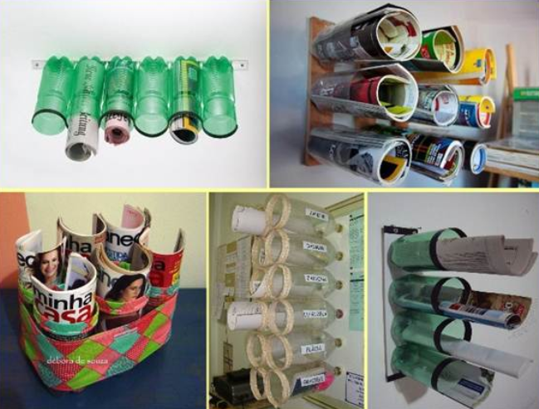
2. Magazine Rack
Love your favourite magazines but hate the clutter they create? Cut up old plastic bottles to make these functional newspaper and magazine organizers. All you need are scissors, paint, tape and a way to mount them, and your house will be greener and more organized.

Slide 18
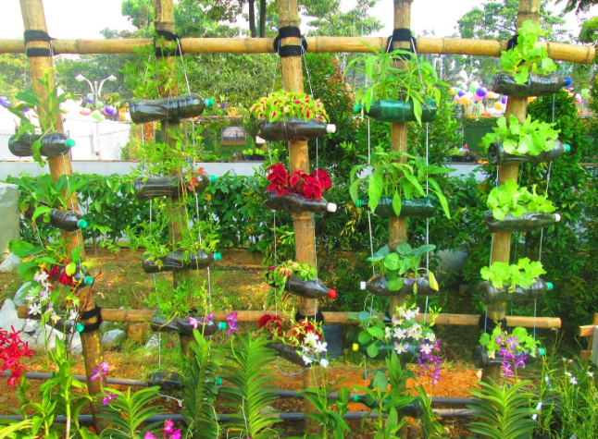
3. Vertical Hanging Garden
Vertical gardens are a great solution to many challenges within urban spaces and recycling plastic bottles is a great way to make one for yourself. Any number of bottles can be strung together and hung against a wall, a fence or a railing to create a garden. Remember to choose plastic bottles that are fairly thick and durable, such as soft drink bottles, rather than thin water bottles, which may tear under the weight of soil, plants and water.

Slide 19
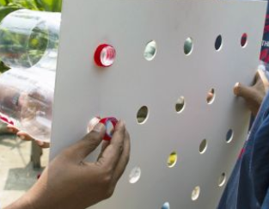
4. Zero Electricity Cooler
To make an Eco-Cooler, cut a piece of board to the size of a window on your house. Then drill holes in the board big enough to push a plastic neck through. Gather some old plastic bottles and cut the bottoms off, then slide the neck of each bottle through the holes and secure them with the cap till the board is full. Hang the board on the window and watch the temperature inside drop

Slide 20
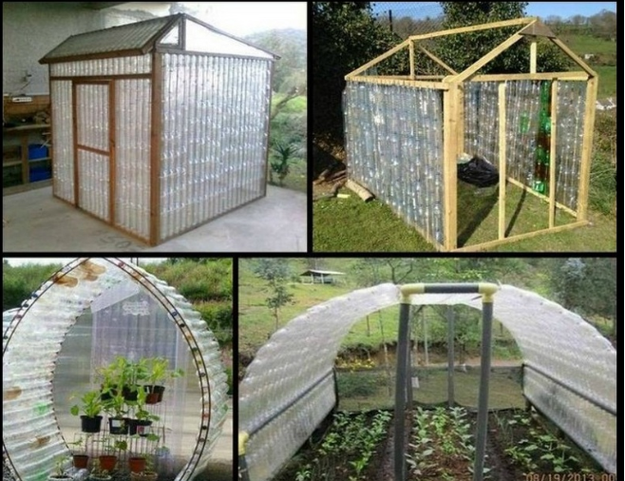
5. Greenhouse
Here’s a great practical project for the whole family – turn used plastic bottles into a greenhouse, and then enjoy the chance to grow your own food once you’ve finished. A great way to turn trash into something really useful, this project is time consuming and takes a bit of effort, but you get an eco-friendly structure at a fraction of the economic or energy costs of a traditional glasshouse.

Slide 21
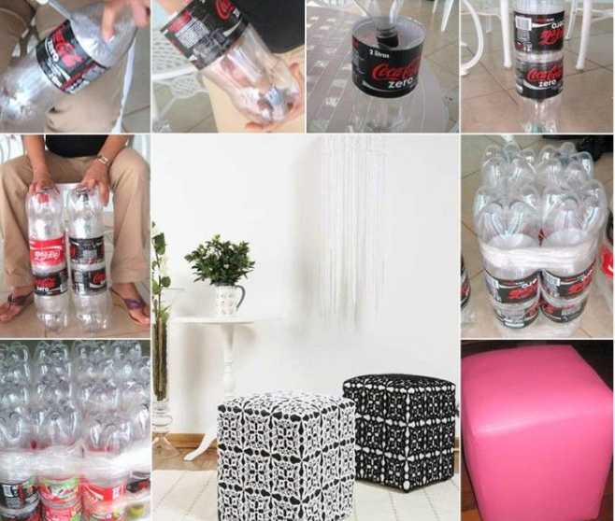
6. Eco-friendly Ottomans
Instead of throwing out old plastic bottles make a custom ottoman for your home from recycled bottles. It’s simple and easy to do, and you won’t have to spend a fortune either on this project, which repurposes throwaway bottles into basic furniture.

Slide 22
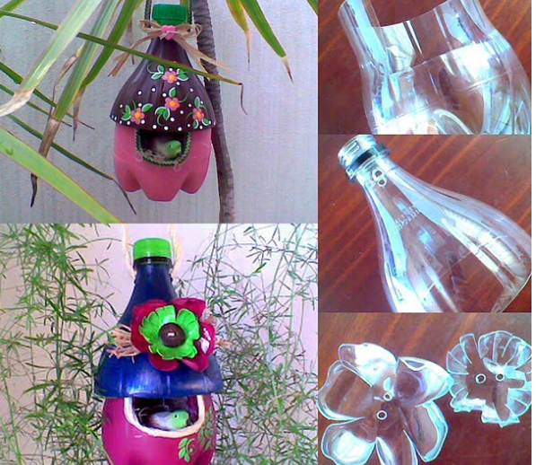
Other Reused option
7. Bird House Tree Decor

Slide 23
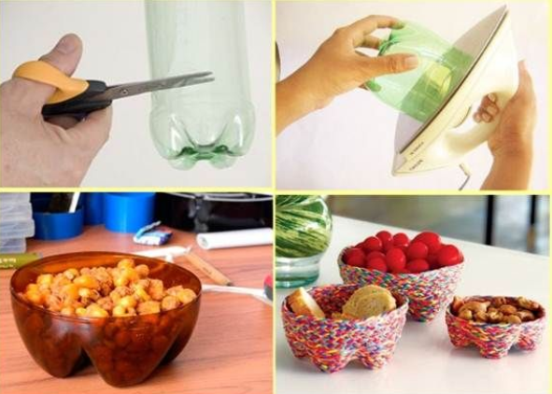
Other Reused option
8. Snack Bowls

Slide 24
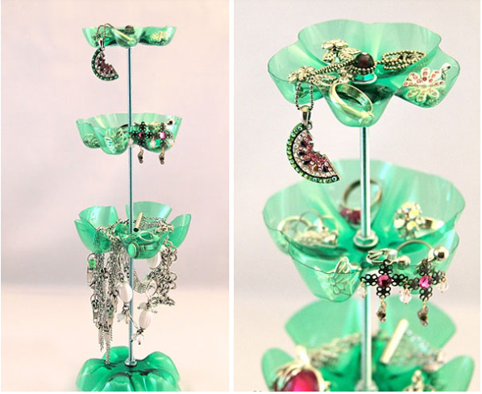
Other Reused option
9. Jewellery Stand

Slide 25
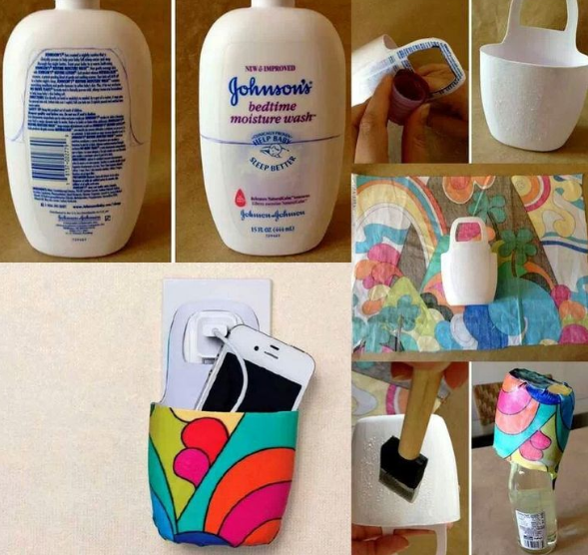
Other Reused option
10. Mobile Charger Basket

Slide 26
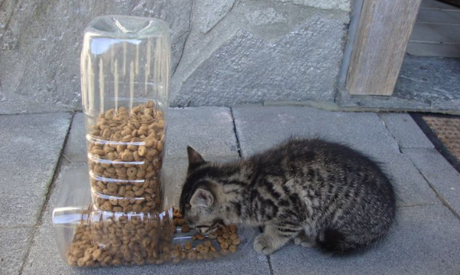
Other Reused option
11. Plastic Bottle Pet Feeder

Slide 27
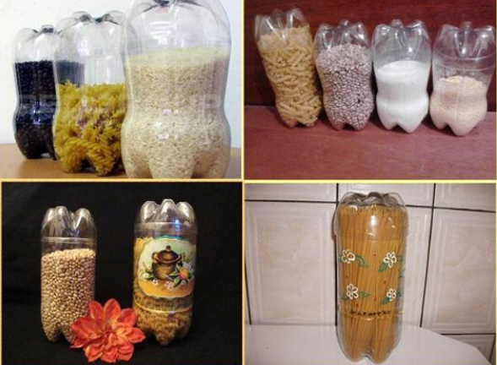
Other Reused option
12. Kitchen Storage Containers

Slide 28
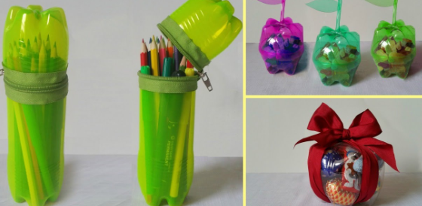
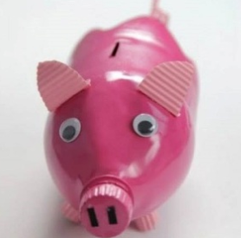
Other Reused option
13. No-Sew Zipper Cases
14. Piggy Bottle Bank

Slide 29
Thank you

