Slide 1
Innovation

Slide 2
Meaning of innovation
A simple or complex idea which make a difference in the world and which is not been thought by some one till yet or invented.

Slide 3
Idea’s which have changed the world
Some ideas which have changed the world are:
Till the time we were not having google we had to trust on our book and the things we heard from our surroundings but now due to google the area of research and development had a huge rise.

Slide 4
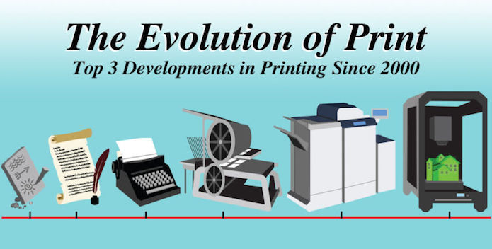
Advantages of these innovations
You can bring changes to the field of that product in a way that every thing of the product changes.
You could do the unexpected or the things which were never imagined by the human. Eg- the innovation of a 3D printer it was never thought by anyone but it happened .

Slide 5
Disadvantages of these innovations
You cannot do whatever you like to or think about as some things need to be thought about practically. Eg- we cannot add a tent to a drone.
They can affect the world in a bad way as the innovation takes place in a bad and a good manner. Eg- the innovation of weapons and bombs has lead to the mass destruction and a huge amount of loss in life of the common people.

Slide 6
Top three steps for the art of innovation

Slide 7
Step -1
Making a meaningful idea:
The idea should have the thinking of making a product which can be used for the betterment of the people and bringing a change or a new wave. If the the idea is having the intentions of making money then the idea will not work.

Slide 8
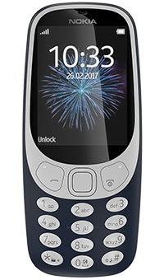
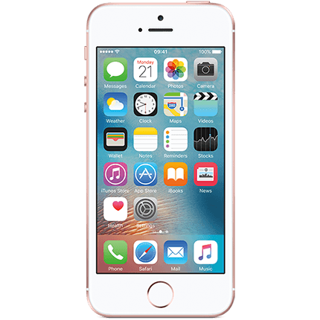
Step -2
This is the cliff of old to the cliff of a change
To think bigger to be the change:
The change can be only brought when the person or a company does something with which everything changes. Eg- If apple had not made an iphone with a full screen touch display we would still be using a phone with buttons. A better vision a better thinking can bring a change which can change the world

Slide 9
Step -3
Do not think that you can not build a crappy product:
Every revolutionary product has some downs. I mean that do not make a bad product but make a product with some flaws in it. Every product cannot give you everything so sometimes you need to compromise in the looks or the internal features of the product.

Slide 10
Monica Joshi Sat Paul Mittal School India
Our Innovators:
Ojas Kapoor
Harsimar
Aditya
Saket
Krish
Gulnaaz
Barbie Chawla
Srijan Chopra
Namya Joshi

