Slide 1
What is innovation
School of Solone №1
Ukraine
Week 1

Slide 2
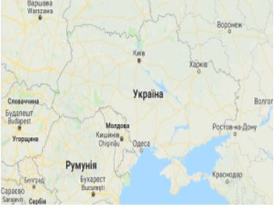
Ukraine
Ukraine is situated in the east of Europe. The territory of Ukraine is 603 700 square kilometres. Ukraine borders on Russia, Belarus, Poland, Moldova, Slovakia, Hungary, and Romania. It’s washed by the Black Sea and the Sea of Azov and has very important ports. 5% of Ukraine’s territory is mountainous; the rest part of the Ukrainian area is flat. Ukraine has the Carpathians and the Crimean Mountains. The Dnieper is the main river of the country; moreover, it’s the third longest river in Europe.The population of our country is about 46 million people. Besides Ukrainians the representatives of many other nationalities live there: Russians, Jews, Belarusians, Moldavians, Romanians, Greeks, Tatars, Poles, Armenians, Germans, Gypsies and other ethnic minorities.The biggest cities of Ukraine are Kyiv, Kharkiv, Lviv, Dnipropetrovsk, Zaporizhzhya, Donetsk, Odessa, Mykolaiv and others.Ukraine is developed industrial and agricultural country. It’s rich in iron ore, coal, natural gas, oil, salt and other mineral resources. Ukraine has such branches of industry as metallurgy, machine-building, power industry, chemical industry and agriculture. Scientists of Ukraine make their contributions of important discoveries and inventions to the world science.

Slide 3
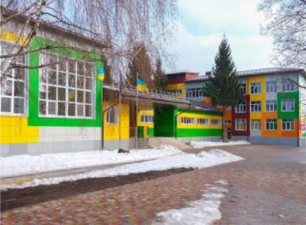
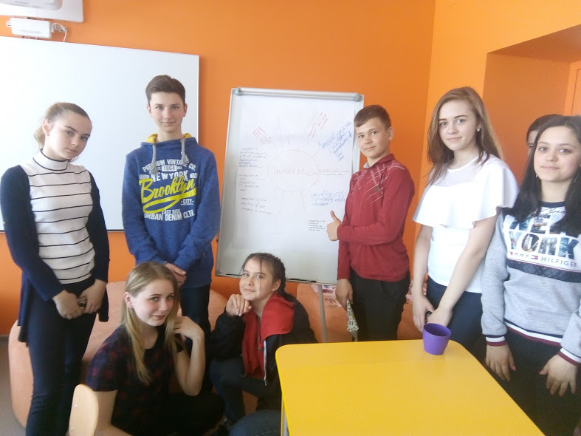
Welcome to our school

Slide 4
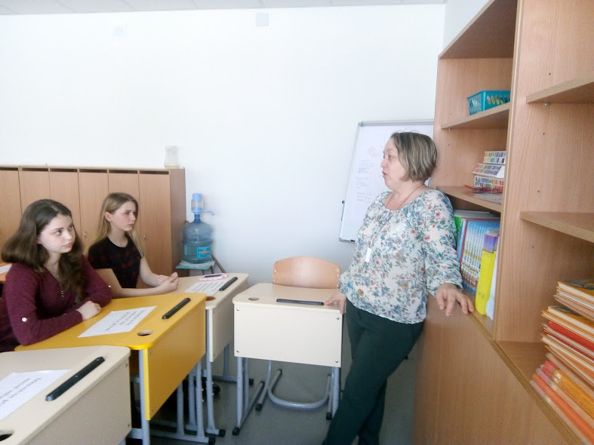
Introduction
We discussed the question What is innovation and sum up the results in our presentation. The pupils worked together in group ,shared opinions and represent their ideas.

Slide 5
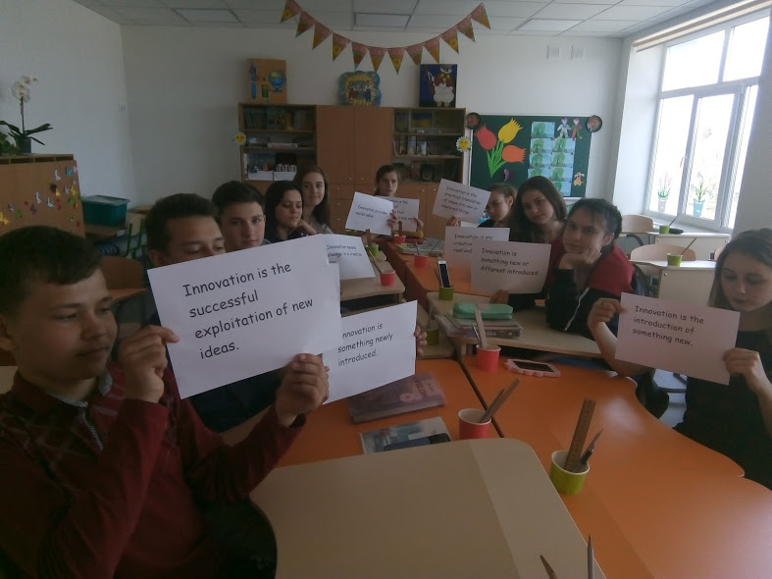
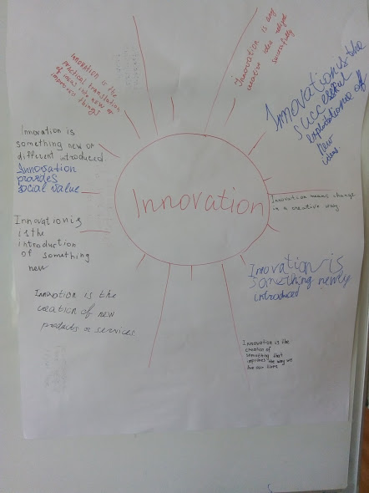
What is innovation ?

Slide 6
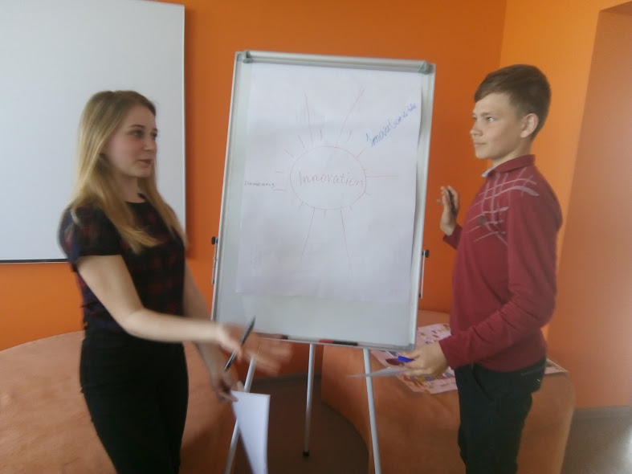
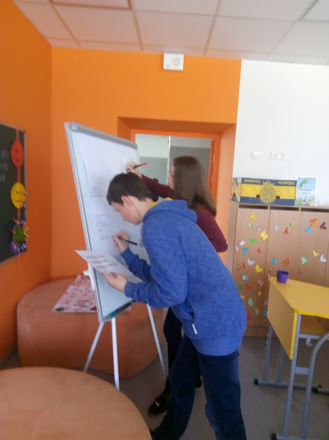
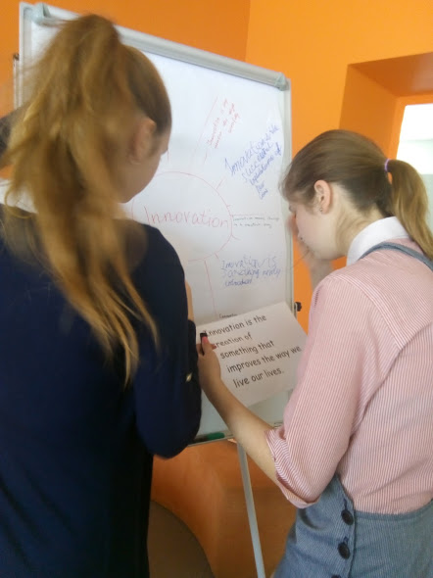
Brainstorming

Slide 7
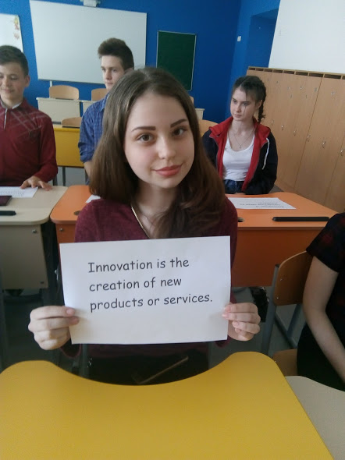
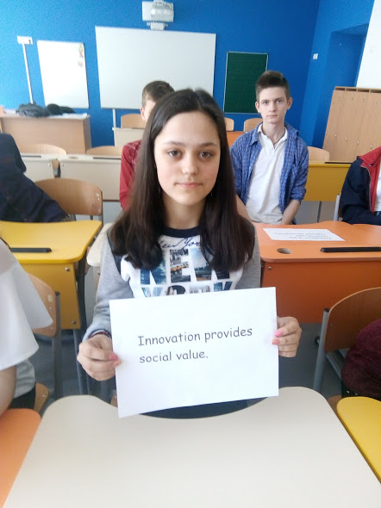
Innovation is …

Slide 8
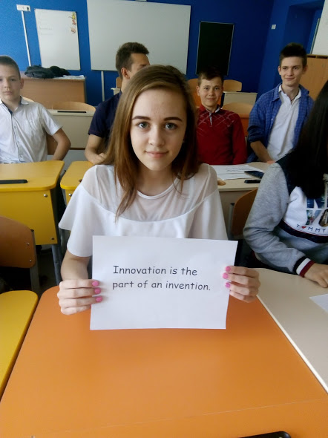
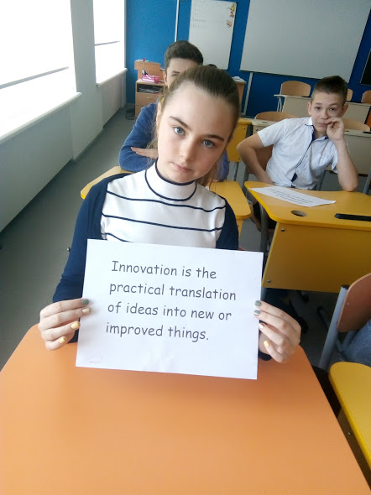
Innovation is …

Slide 9
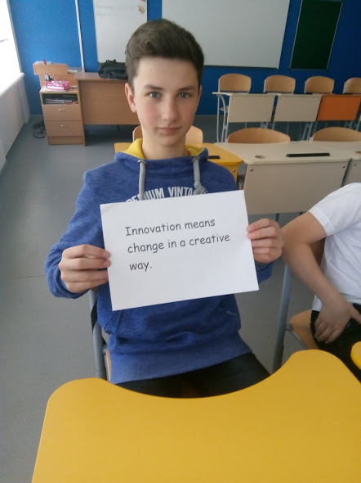
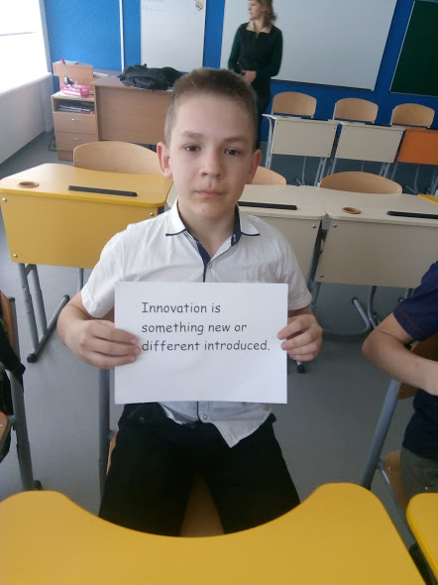
Innovation is …

Slide 10
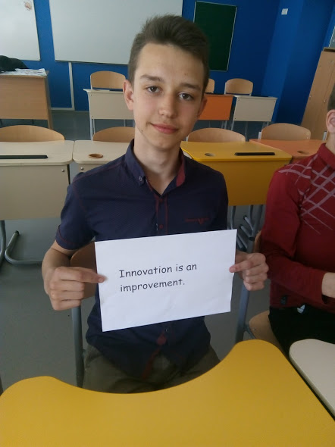
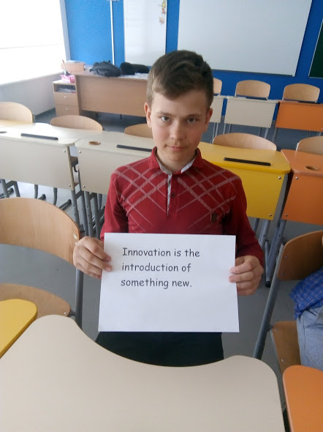
Innovation is …

Slide 11
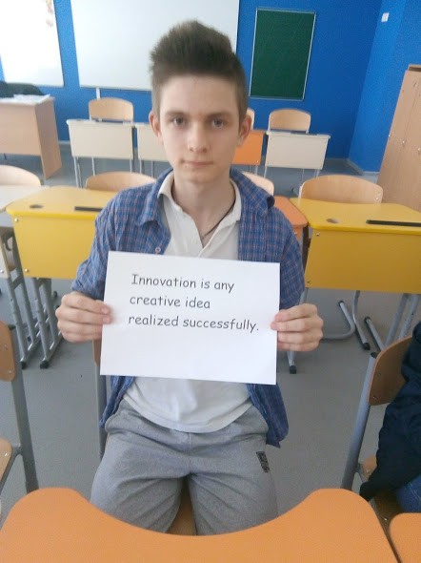
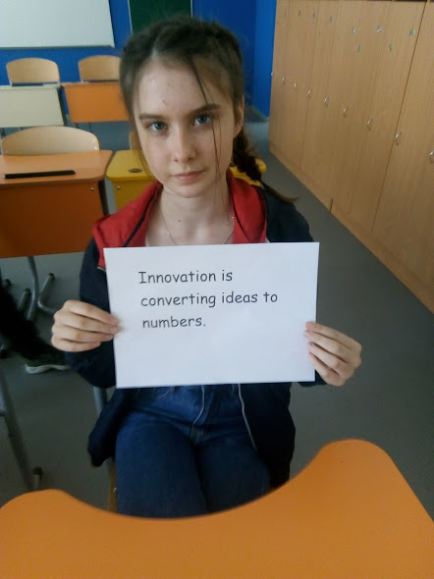
Innovation is …

Slide 12
We got new Skills :
-Collaboration,
-Knowledge building,
-ICT for learning,
-Real world problem solving
-Self-regulation

Slide 13
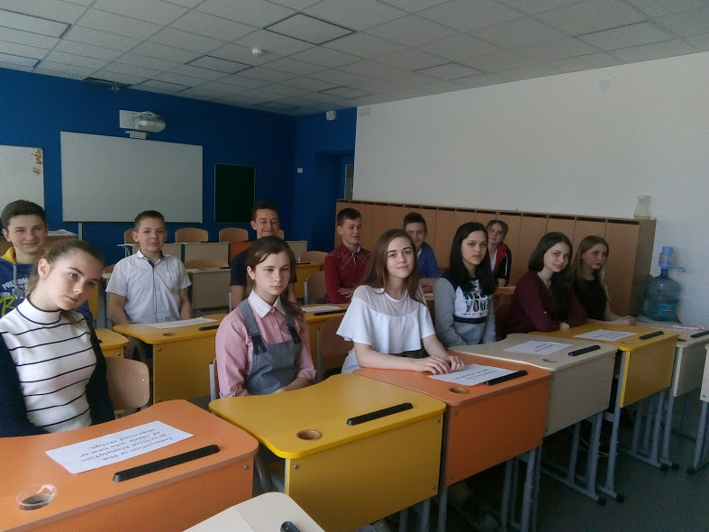
It was a big work of a good team !

