Slide 1
Innovation Project: Week 1
by: Aayush lath
from: kulachi hansraj model school, India

Slide 2
What is Innovation?
I think Innovation is the process transforming an idea, invention or method into a service that meet the need of existing or new system.
The classic definitions of innovation include:
the introduction of something new.
a new idea, method or device.
the successful exploitation of new ideas.
Also watch this YouTube video about innovation which is very inspiring :The art of innovation.
Some examples of brilliant innovations are Hyperloop, Social Media.

Slide 3
Benefits, Unexpected side effects and Drawbacks of Different Innovations
Every innovation be it social media or hyperloop have some side effects and drawbacks. Here I am explaining with the help of the example of social media ha how it was meant to be a great communication but in sight of this also gave to a new term name as cyber-bullying which intern is a very harmful side effect. Social media companies like Facebook are also leaking user’s data which is also not good.
If look in the case of apple it is also deliberately slowing the old iPhones which is not good.
But there are numerous benefits also of these innovations like the processors of iPhones are lightening fast where are android processors are not anywhere near them. Social media is also a great platform for the spreading of news, connecting with family and friends, chatting etc.

Slide 4
Why ‘Innovation Alone is Not Enough’ and When will mankind decide we have had enough innovation?
"Innovation alone is not enough“ as, just think if there are many great innovations which are in the mind of people, students or a small child which can completely change the world but if they are not implemented correctly there are in vain.
It is difficult to say that mankind will ever decide that we have done enough innovations as the need and hunger of the man keeps on increasing by time.

Slide 5
Imagining the world, my house and classroom in 2030 And Innovations Which are not Benefitting the People
I think that in 2030 innovations would have taken up every current thing like the cars might be flying or the houses may be integrated with a perfect artificial intelligence software and the classrooms might have a great environment of teaching with help of augmented, virtual reality or holograms which in tern would help the students to help and grasp things in a better way.
However there may be many fascinating prediction about the future it is impossible to predict future very clearly.
Like I previously mentioned that apple is deliberately slowing the iPhone it is an innovation which is not at all benefitting the people in any way. Either it is helping apple to increase its sale.

Slide 6
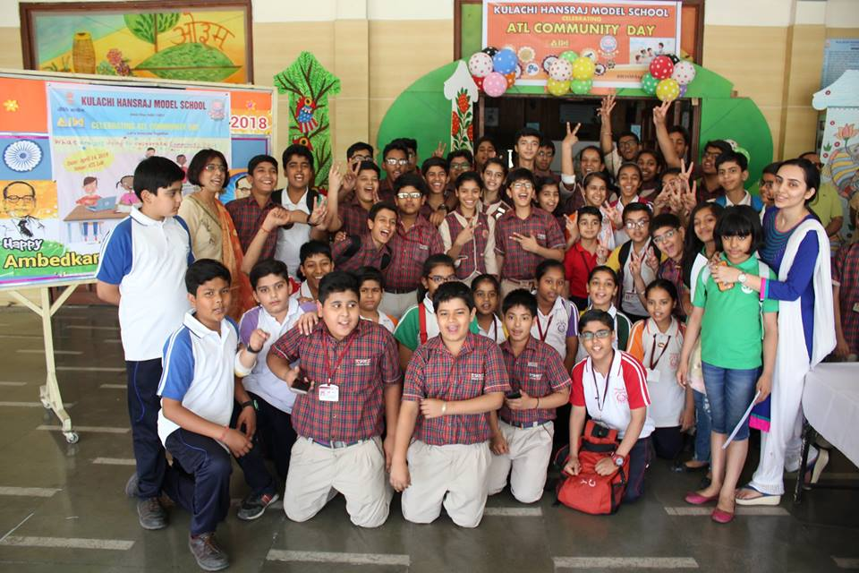
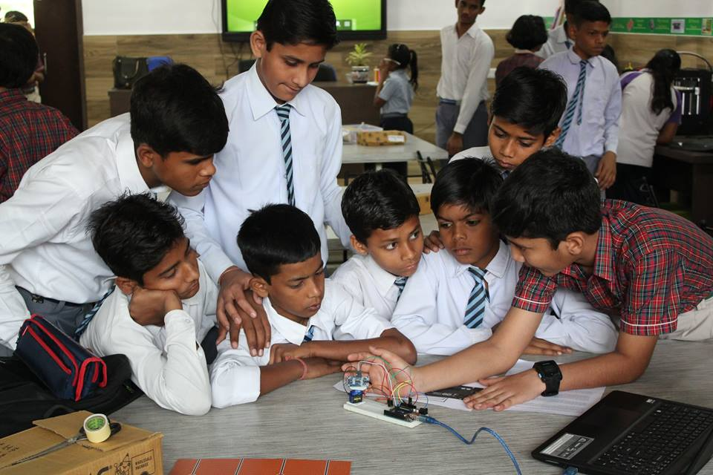
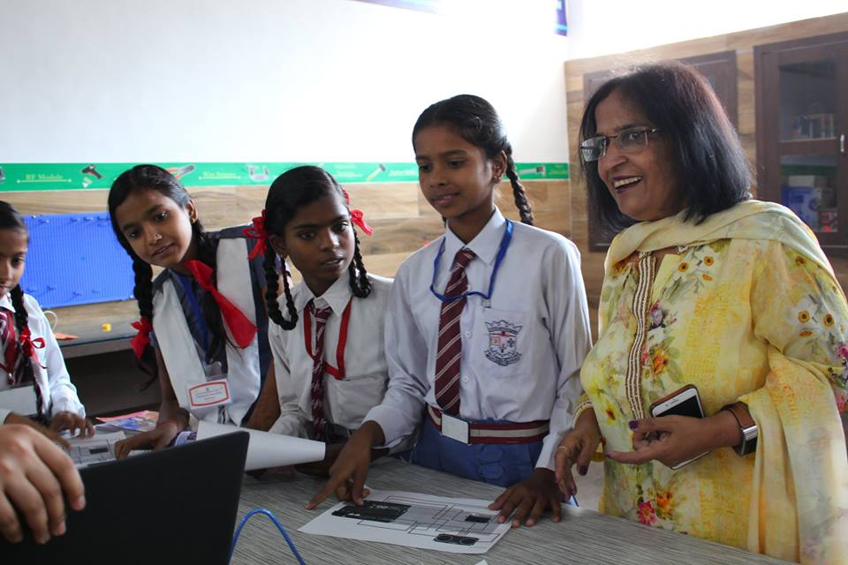
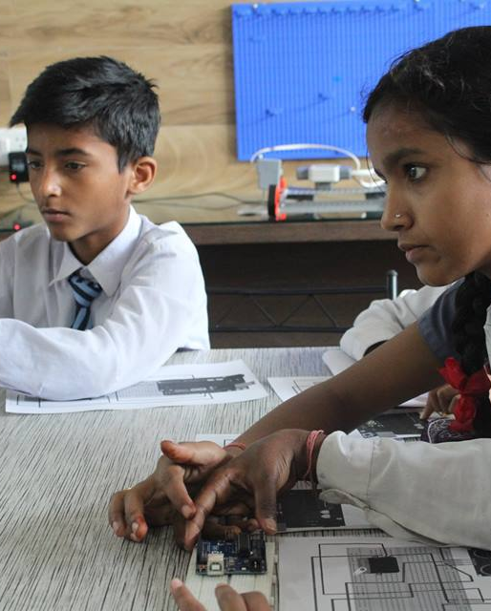
Innovations Done by Me and My School
My school Kulachi Hansraj Model School is doing many innovations and is also organizing various events, workshops and competitions in the school premises.
Recently the ATL Community Day was Being held in the school on April 14, 2018 in which various kinds of activities like 3D- Printing, Arduino based projects, Robotronics based kits were also present. Participating students were of not only our school but also of different other government and private school. This day is celebrated every year on the birth anniversary of Dr. B. R. Ambedkar.

