Slide 1
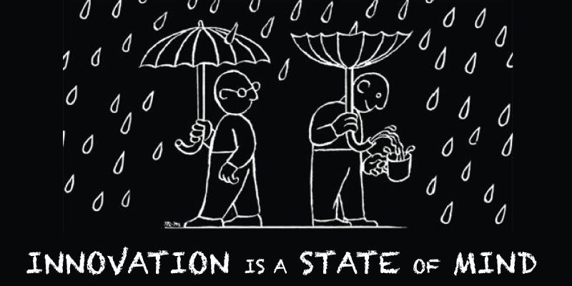
INNOVATION
Is it something we dream of? Something we seek? Can we even describe what innovation truly is? Maybe not, but we know for sure that progress is progress no matter how small and that allows us to create and find ideas every day. This makes us humans.

Slide 2
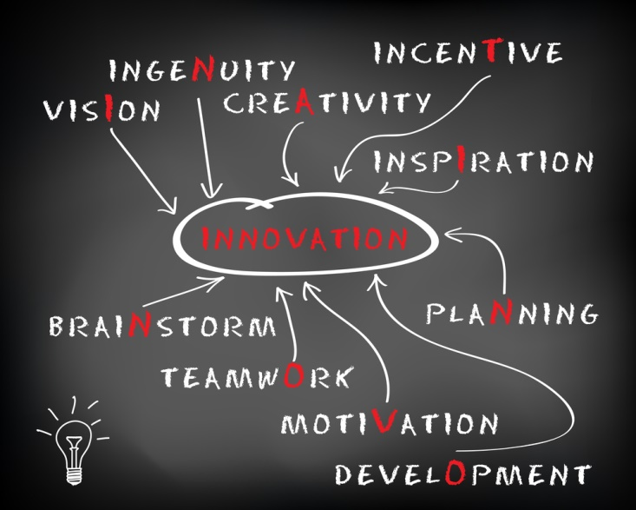
What is it?
The simplest definition of innovation is creating a new way to do something, coming up with new ideas or methods that prove to be more effective and to waste less resources. The principal idea innovation is based on is spend less, make more. This fundamental concept builds the effect of “new” from zero, which basically means that something is unknown, so it is unused. Not quite. For us “new” means something undiscovered that was brought to the surface by someone or something. That, however, doesn’t mean that all the innovation is brought from “new”, but rather from incomprehensible. Yet we can’t really comprehend everything, and we never will.

Slide 3
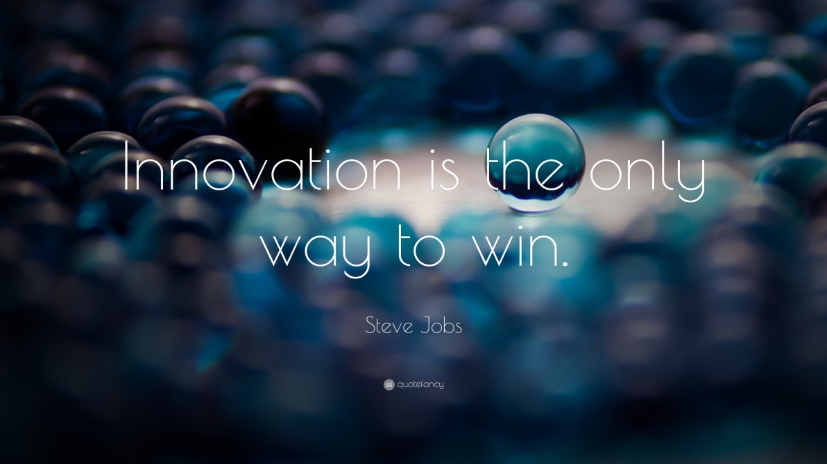
According to Steve Jobs, “Innovation is the only way to win.” Taking what he did to reach so high and create what is known as “Apple” today, we can affirm it’s true. Being so motivated to think outside the box and inspired to create a NEW invention led to a marvelous innovative company. What does it take to be strong enough to find the path and walk it to the end? Most probably creativity.

Slide 4
Where does innovation occur?
Usually innovation appears in technology and engineering, because these are principal fields when speaking about new and good. Although new is not necessarily good or bad, we find out how things can be interpreted. Many ideas are, for starters, believed to be bad or simply useless. That is because most people needs are not included in these. But sometimes people don’t know what they want. They like almost any crazy invention that makes something easier, even when it’s exaggerated. Some ideas might be beneficial, while others might slowly become dangerous and will end up destroying the whole system within.
Just as Stephen Hawking said: ”Artificial intelligence might be humanity’s biggest mistake”

Slide 5
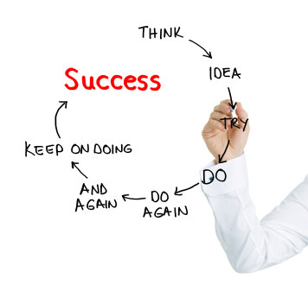
Goals and failures
Not only essential while covering the “innovation” but also inevitable. Failures represent a significant part in progressing. They obligate you to learn and do better, harder. They walk you through pain and misery but in the end they raise you higher than the sky and the space. Goals, on the other hand may create a fake feeling in your head, a fake feeling of progressing. That usually happens when you do not act, so you can’t see the obstacles. It’s like hitting a wall and not looking for a way around it, so you lay there forever, lying to yourself.

Slide 6
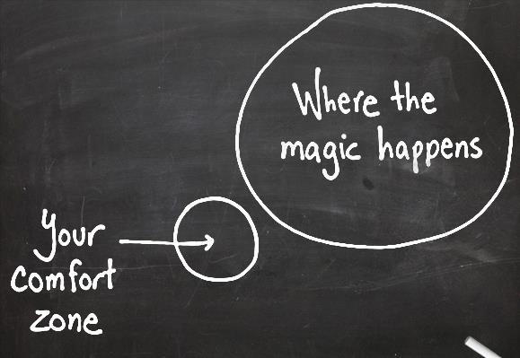
Our perception upon achieving goals is sometimes wrong and distracting. We find ourselves a comfortable spot in what we do and we don’t get out of it. The problem persists,ultil something decides to pop up and ruin your plan. This problem is treated only by experiencing it youself and realizing how dangerous stopping can be. Because Elon Musk says: “Failure is not an option here. If things are not failing,you aren’t innovating enough.” So you should keep going until rock bottom for 2 reasons: You can’t fail if you don’t try and because we always like to push our limits. Do not stop until you physically and psychically cannot continue. But you would.

Slide 7
INNOVATION
The conclusion is supposedly that innovation does not mean good or bad, means efficient, and most importantly, new. We cannot survive without our lives being constantly updated and we must adapt. That’s all there is to it.
Written by:
Alex Constantinescu; Iosif Teodor and Licarete Tudor

