Slide 1
LOW COST
AIR PURIFIER
Made By :-
Preksha Singh,Rudraksh Agarwal
Class:8
Delhi Public School Ghaziabad

Slide 2
AIR POLLUTION
The lower the levels of air pollution, the better the circulatory and respiratory health of the population will be, both long- and short-term.
The "WHO Air quality guidelines" provide an assessment of health effects of air pollution and thresholds for health-harmful pollution levels.
Ambient (outdoor air pollution) in both cities and rural areas was estimated to cause 3.7 million premature deaths worldwide in 2012.
Some 88% of those premature deaths occurred in low- and middle-income countries, and the greatest number in the WHO Western Pacific and South-East Asia regions.

Slide 3
WHAT IS AN AIR PURIFIER????
An air purifier is a device which removes contaminants from the air in a room. Air purifiers may also be used in industry to remove impurities such as CO2 from air before processing. Pressure swing absorbers or other absorption techniques are typically used for this.

Slide 4
COMPONENT OF AN AIR PURIFIER FROM MARKET
HEPA filters
The glass fibers that make up a HEPA filter are created by passing molten glass or plastic through very fine pores in a spinning nozzle. The resulting glass fibers cool and harden almost instantly because of their tiny diameters.
The activated carbon filter
1 The activated carbon filter (for odour reduction) usually consists of carbon-impregnated cloth or foam. This is manufactured by infusing the raw material with powdered activated carbon.
The fan
An electric fan is used to pull air through the air purifier.
Assembly
3 There are very few components in an air purifier. For this reason, they are usually bench assembled. In bench assembly, moving conveyors bring the individual components or sub-assemblies (e.g., the fan already attached to the case) to a bench where a person then hand assembles them.

Slide 5
ADVANTAGES OF AIR PURIFIER
They are very helpful devices for people who suffer from asthma or allergies.
Air purifiers serve residential as well as commercial needs. Commercially air purifiers serve various industrial, medical and commercial industries.
Air purifiers have HEPA (high efficiency particulate air) filters that aid in cleaning the air around that is circulated. They help get rid off contaminants and impurities from the air.

Slide 6
DISADVANTAGES OF AIR PURIFIERS
Air purifiers require constant maintenance and cleaning. The problem with these devices is that some purifiers clean dust but are not helpful with odours; others remove odours but don’t do much for the dust.
Research has proved that air purifiers might support in removing impurities and contaminants from the air but it is very complicated to free the air of odours and gases.
They are also very costly to buy.

Slide 7
MATERIAL WE USED TO MAKE THE AIR PURIFIER
MATERIAL USED WAS -:
2 Containers
An aquarium aerator
Lime (Calcium Carbonate)
A desert cooler
pH paper

Slide 8
REACTIONS FOR THE LIME BASEDAIR PURIFIER
CaO + H₂O ---------> Ca(OH)₂
Ca(OH)₂ + CO₂ ---------> CaCO₃ + H₂O
Ca(OH)₂ + SO₂ ---------> CaSO₃ + H₂O
Ca(OH)₂ + NO₂ -------------> CaNO₃ + H₂O

Slide 9
AIR PURIFIER FOR SUMMERS
Our air purifier works in two phases, one for summers and the other for winters.
For the summers, we took a desert cooler and tested the pH of water, it was 7 (neutral).
Then we let the cooler run for a few hours and then tested the pH, it was 5(acidic) because the acidic gases present in the air like CO2, SO2 get dissolved in the water and form Sulphurous acid, carbonic acid etc.
In order to neutralize the acid, we took a separate container and added 100 of lime in it. Then we mixed the lime with water. We tested its pH, it was 10 (base).
We next filtered and mixed lime water, with the water present in the cooler, and let it run for a few more hours and tested the pH after that, it was 8 (weakly basic).

Slide 10
AIR PURIFIER FOR WINTERS
For the winters, when we do not require cool air, but still need purified air, we took a container, filled it with water, and fixed an aerator (a device used in the aquariums to aerate the water for the fishes) in the container, we tested the pH of water, it was 7 (neutral).
Then we let the aerator run for a few hours and then tested the pH, it was 5(acidic) because the harmful gases present in the air like CO2, SO2 get dissolved in the water and form sulphurous acid, carbolic acid etc.
In order to neutralize the acid, we took a separate container and added some lime in it. Then we mixed the lime with water. We tested its pH, it was 10 (base).
We next mixed the lime water, with the water present in the container, and let it run for a few more hours and tested the pH after that, it was 8 (weakly basic).

Slide 11
CONCLUSION
THE LIME, WHICH IS A BASE, NEUTRALIZES THE ACIDS PRESENT IN THE WATER. THEREFORE, CLEANING THE AIR.
WHY OUR PURIFIER??
THE PURIFIERS, AVAILABLE IN THE MARKETS ARE VERY COSTLY AND RANGE FROM ABOUT Rs.7000 TO Rs. 40000 WHEREAS OUR PURIFIER IS VERY economical it costed us only Rs. 300.

Slide 12
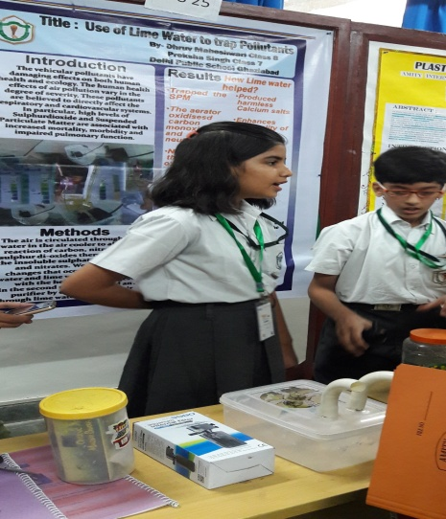
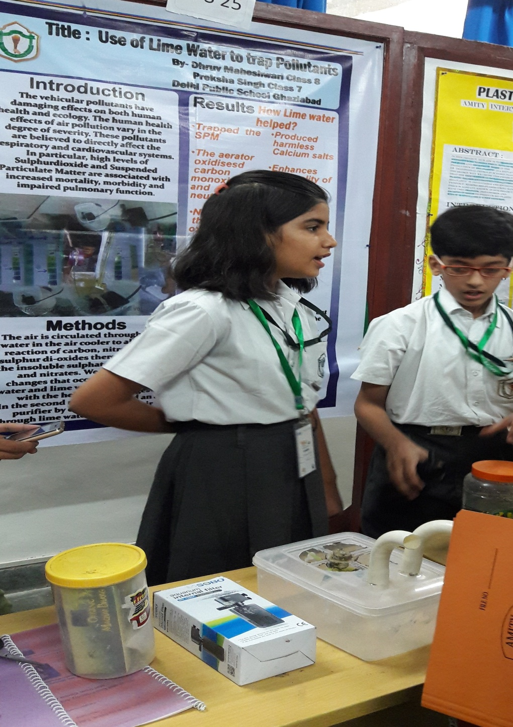
Few Glimpses……

Slide 13
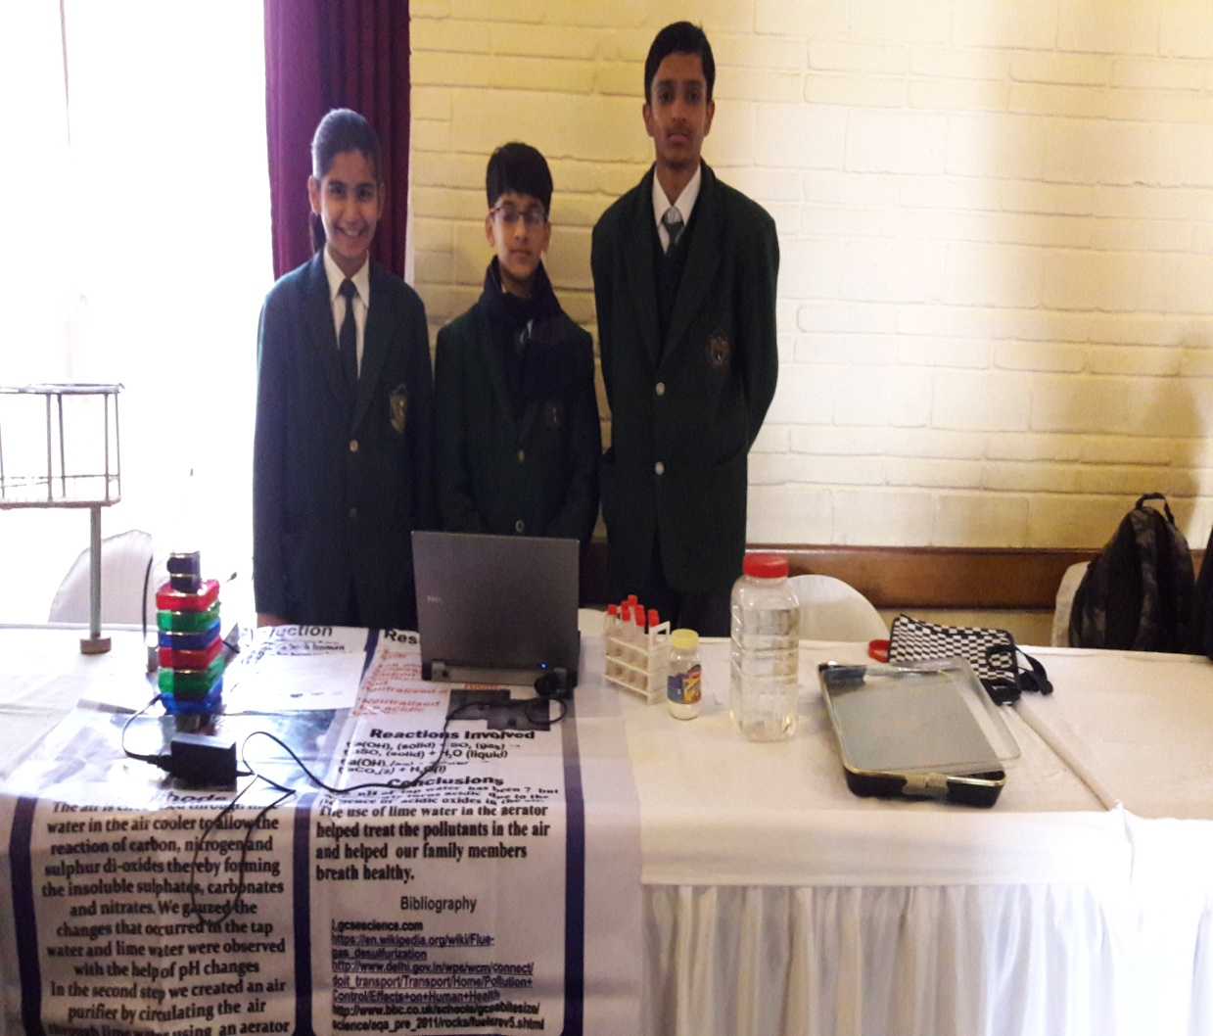
Continued…

Slide 14
References
http://www.who.int/mediacentre/factsheets/fs313/en/

